Slide 1


Computer Forensics Process
Godwin S. Monserate

Slide 2
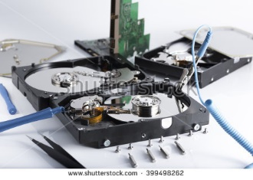

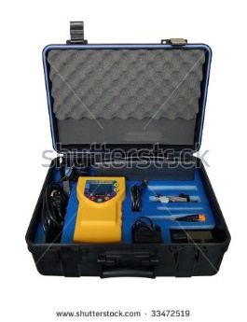

Objectives of the Session(1)
Sources of Evidence
Acquire evidence using forensic techniques
Use of forensic tools
Digital evidence analysis

Slide 3


Objectives of the Session(2)
Solving a Case
Apply and use forensic techniques

Slide 4
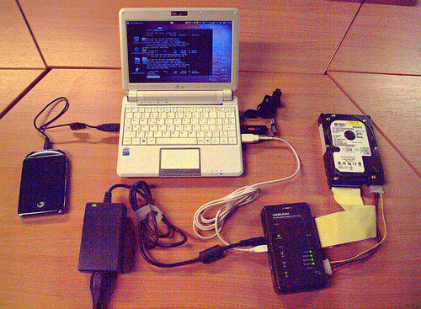
Digital Forensics
Also known as Computer Forensics
Considered to be the use of analytical and investigative techniques to identify, collect, examine and preserve evidence/information which is magnetically stored or encoded
The objectives are:
Main objective is to find the criminal which is directly or indirectly related to cyber world
To find out digital evidences
Presenting evidences in a manner that leads to legal action of the criminal in the court of law

Slide 5

Digital Evidences
Any data that is recorded or preserved on any medium in or by a computer system or other similar device, that can be read or understand by a person or a computer system or other similar device.
Information and data of value to an investigation that is stored on, received, or transmitted by an electronic device.
In the legal world, Evidence is EVERYTHING
Evidence is used to establish facts

Slide 6


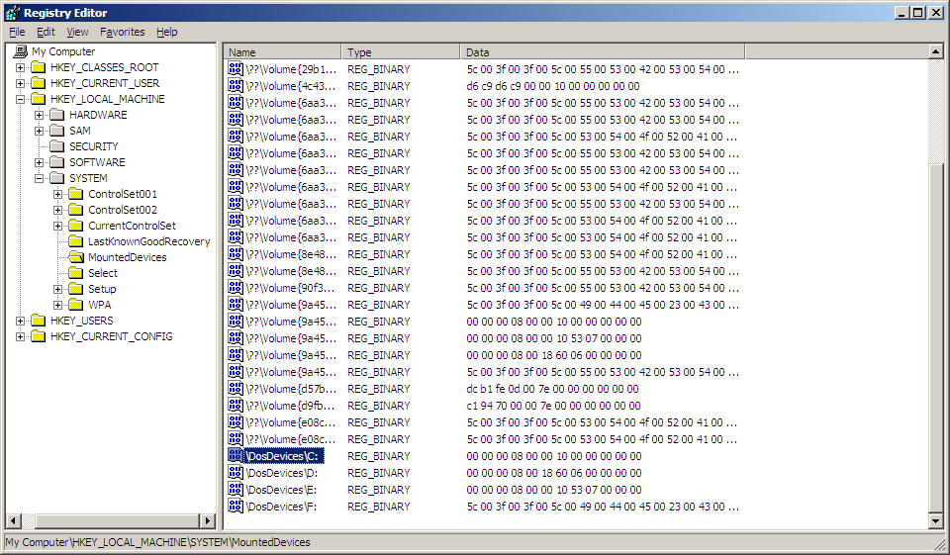
Types of Digital Evidence
Persistent Data
Data that remains intact when the computer is turned off.
E.g. hard drives, disk drives and removable storage devices(such as USB drives or flash drives)
Volatile Data
Data that would be lost if the computer is turned off.
E.g. deleted files, computer history, the computer’s registry, temporary files and web browsing history.

Slide 7
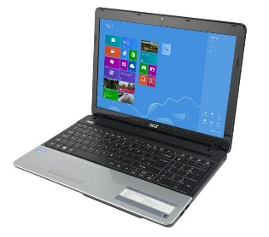
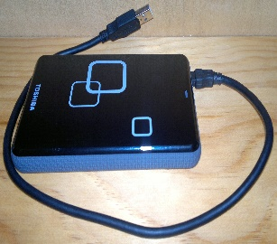
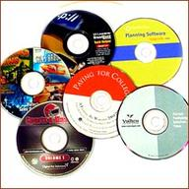
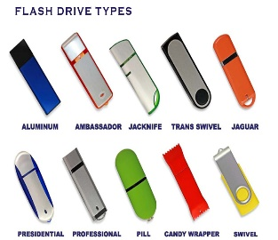
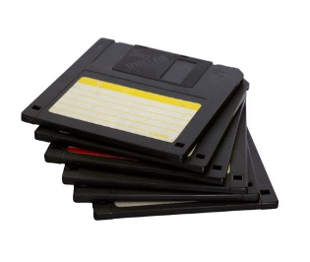
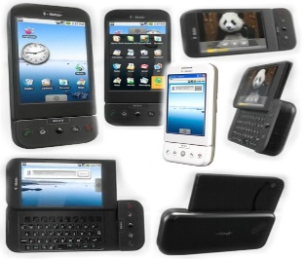
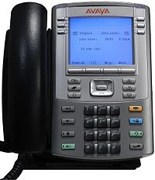
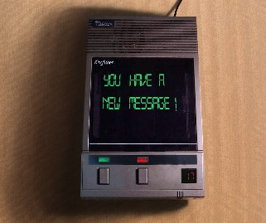
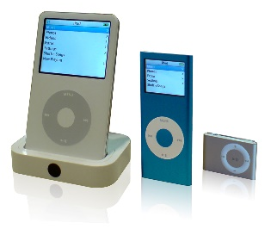
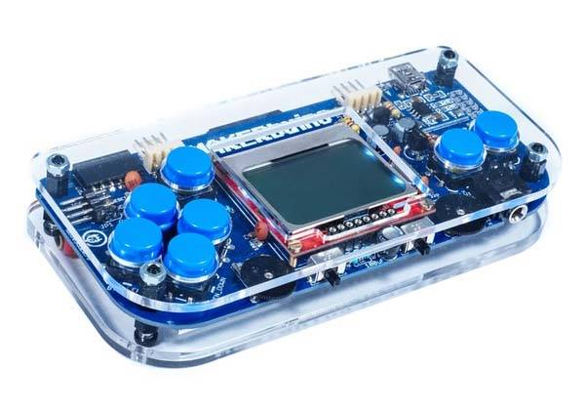
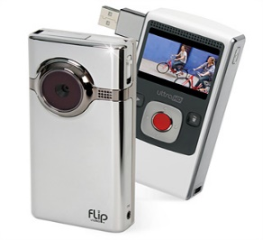
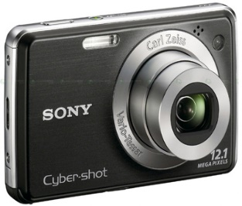

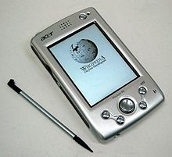
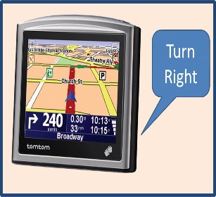
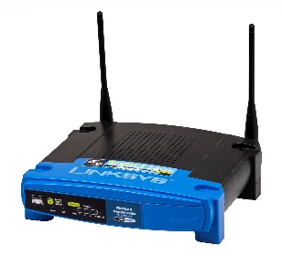

Sources of Evidence
Computers
External hard drives
CD’s and DVD’s
Thumb drives
Floppy disks
Cell phones
Voice over IP phones
Answering machines
iPods
Electronic game devices
Digital video recorders
Digital cameras
PDAs
GPSs
Routers
Switches
Wireless access points

Slide 8
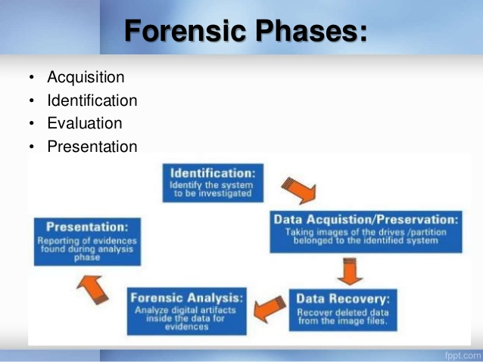

Slide 9
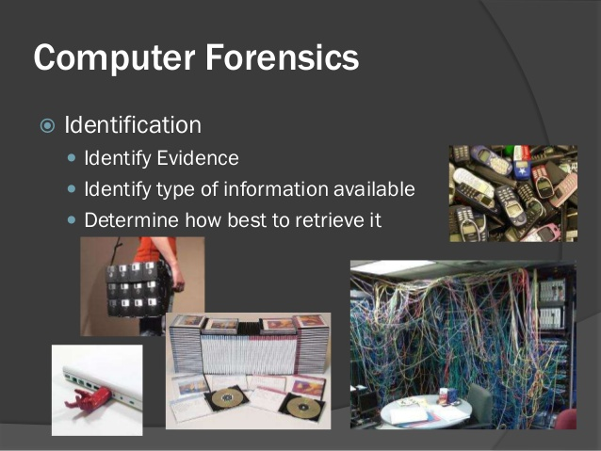
Computer Forensics Process(1)

Slide 10
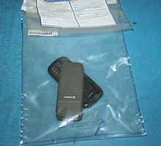
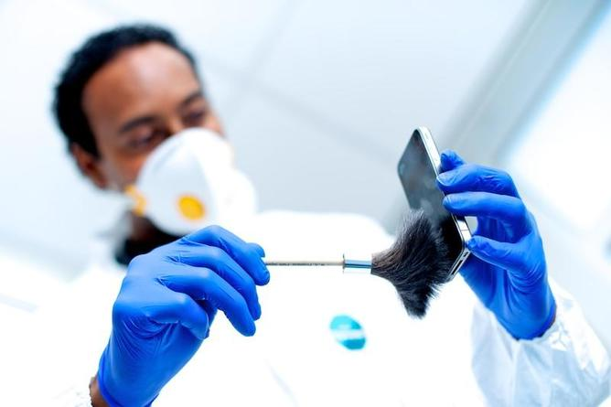
Handling Digital Evidence at the Scene(1)
First responders may follow the steps listed below to guide their handling of digital evidence at an electronic crime scene:
Recognize, identify, seize and secure all digital evidence at the scene.
Document the entire scene and the specific location of the evidence found.
Collect, label, and preserve the digital evidence
Package and transport digital evidence in a secure manner
Before collecting evidence at a crime scene, first responders should ensure that –
Legal authority exists to seize evidence.
The scene has been secured and documented.
Appropriate personal protective equipment is used.

Slide 11


First thing to be done at the crime scene
When seizing a stand alone computer at the crime scene:
If the computer is “POWERED OFF”, do not turn it ON(turning it “OFF” could activate lockout feature)
If the computer is “POWERED ON”, do not turn it OFF and do not allow any suspect or associate to touch it(turning it “ON” could alter evidence on device)

Slide 12

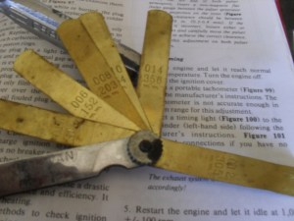
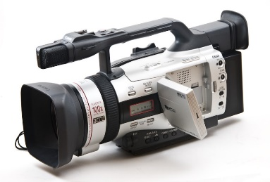


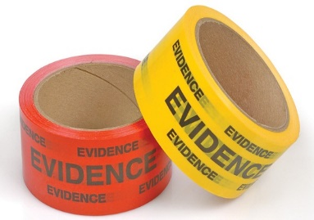
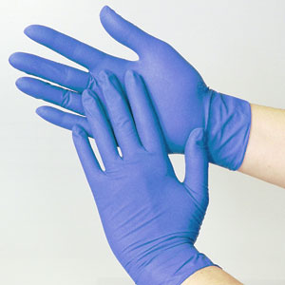
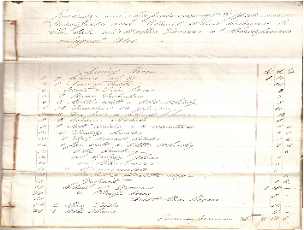
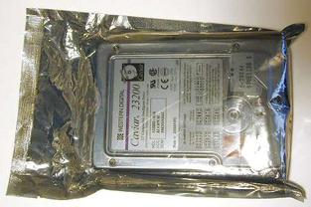

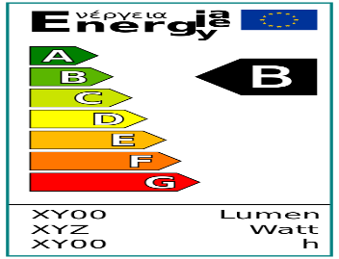
Tools and Materials for Collecting Digital Evidence
Aside from tools for processing crime scenes in general, first responders should have the following items in their digital evidence collection toolkit:
Cameras(photo and video)
Cardboard boxes
Notepads
Gloves
Evidence inventory logs
Evidence tape
Evidence stickers, labels, or tags
Crime scene tape
Antistatic bags
Permanent markers
Nonmagnetic tools

Slide 13
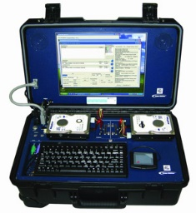

Acquisition/Preservation(2)
Taking images of the drives/partition belonged to the identified system.
Physically or remotely obtaining possession of the computer and external physical storage devices.
Imaging is a bit for bit copy of the original evidence.
It is much different than a simple copy and paste, because it maintains file structure present on the disk.
Imaging can be time consuming process for a digital investigation, it is a step that cannot be avoided.
Reasons why digital evidence needs to be imaged.
Most important reason is to uphold the integrity of the original media that was seized from the crime scene or suspect
Allows investigator to add multiple evidence items to a single analysis tool
Allows investigator to process all of the digital evidence for a case at one time, which will speed up the analysis process

Slide 14




Number of Images Needed
While the process of imaging can be different depending on the examiner or office procedure, the number of images should be a standard that is maintained for most investigations.
Recommended is a two image standard.
The first image that is created is considered the backup image.
The backup image is an image that is used to create any additional images that are needed.
When not in use, the backup image should be kept in a secure location to avoid outside manipulation of the evidence.
From the backup images a second image is created, which is referred to as the working image. The working image is what will be analyzed by the examiner.

Slide 15
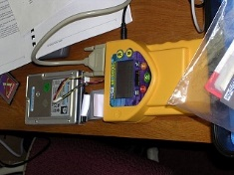


Ways of Imaging/Mirroring
Hardware Imaging/Mirroring
There are hardware duplicators that take a hard drive and mirror it on another hard drive.
One of their big advantages is the speed and the safety.
Example, the Logicube places the capturing disk (the destination) within the encasing and connects the suspect drive at the outside, preventing the most important mistake that the forensics examiner can make, namely to write in the wrong direction and destroy the evidence.
Software Based Forensics Duplication
A number of software products are available that create qualified forensics duplicates.
UNIX dd - The dd utility in UNIX is certified to make forensic duplicates. dd is a UNIX tool, so the original drive needs to be mounted in UNIX. Raw dd duplicates need to be verified with a hashing (signatures), but there are specialized version of dd or scripts that include the verification.
Encase is a very expensive, but very impressive Windows based Forensics suite that includes the making of qualified forensics duplicates

Slide 16
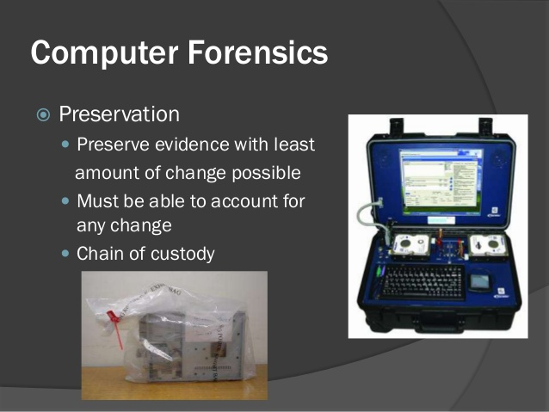
Computer Forensics Process(2)

Slide 17

3 Different Types of Imaging Process
Disk to disk imaging is used when the investigator needs an exact duplicate or clone of the original storage media.
Integrity of the original can be maintained throughout the course of the investigation
Disk to file imaging is much like disk to disk imaging.
Main difference it that instead of a clone of the original a single file is created that represents the original media.
If multiple items are seized from a scene it is possible to image multiple pieces of evidence at one time. This allows the examiner to set up the imaging process and step away.
Multiple file formats that can be used in Disk to File Imaging
dd
This format is a raw data format. Native to Linux/Unix
Very beneficial because many free tools are linux/unix based.
Every bit (0 or 1) that is on the original media is stored in the file.
If the original is a 20 GB hard drive, the result will be a 20 GB dd file.
Files to File imaging is same thing as disk to file imaging except the input is files instead of an entire disk. This type of imaging is mainly used when the scope is limited or the disk has extremely large capacity such as a RAID setup. Files to file imaging is rarely used, but it is essential for the examiner to understand when it should be used.

Slide 18

3 Different Types of Imaging Process
Multiple file formats that can be used in Disk to File Imaging
dd
This format is a raw data format. Native to Linux/Unix
Very beneficial because many free tools are linux/unix based.
Every bit (0 or 1) that is on the original media is stored in the file.
If the original is a 20 GB hard drive, the result will be a 20 GB dd file.
e01
A file format that was created by the developer of the commercial forensics tool Encase.
While the format was developed by the developers of Encase, it can be interpreted by other commercial tools.
Main benefit of E01 over DD is that the image file is compressed in a manner that is forensically sound.
Allows the examiner to save space on the destination storage media.

Slide 19
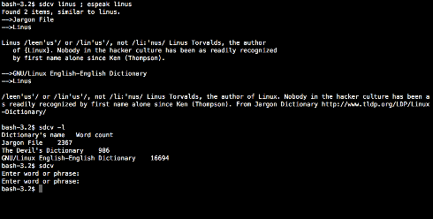
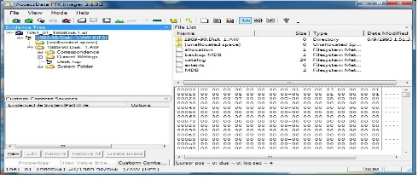
2 Categories of Software Imagers
Imagers that use a command line interface.
The most common command line interface is DD or data dump.
Most command line interfaces used today are linux based.
There are multiple versions of DD, some of which include the hashing function, such as DCFLDD.
The benefit of command line tools is that the user will usually have more control over the tool.
Imagers that use a graphical style interface.
The graphical interface is much easier to use than command line.
Most commercial software imagers on the market will include a graphical style interface.
Example is FTK Imager by Access- Data.
Like most commercial software imagers FTK Imager supports multiple formats, has hashing capabilities, and generates an imaging report.
Like other forms of imaging it is essential that an examiner practice with the tools that he or she is going to use to ensure that they fully understand the capability and procedure of the tools they are using.

Slide 20
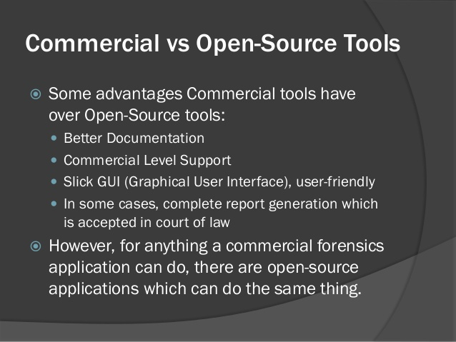

Slide 21

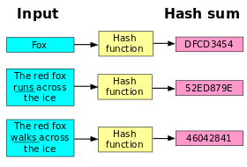
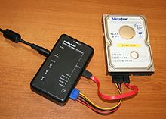
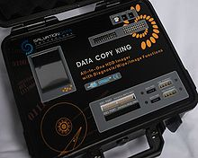
Authentication
Important to continue proper documentation throughout the entire investigation process.
Digital evidence can easily change.
Authentication, supported by proper documentation, can ensure that the evidence does not change once it was acquired and can ensure that the examination machine did not manipulate the original media.
To provide proper authentication, verification takes place using hashing algorithms on both evidence and images.
Hardware write blockers will prevent any change to the original media.

Slide 22

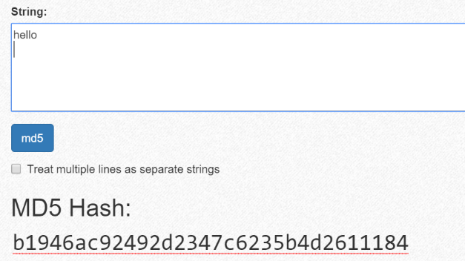
Create Proof of Non-Alteration( Hashing)
For this reason, it is common practice to calculate cryptographic hash of an evidence file and to record that hash elsewhere, usually in an investigator’s notebook, so that one can establish at a later point in time that the evidence has not been modified since the hash was calculated.
Hashing is a one-way function that computes a fixed length output from a variable input.
Any change in the input results in a completely different output due to the avalanche effect.
The input of a hashing function can be any digital stream of data.
This can range from individual files to large storage devices.
The only limitation is that the device must be able to be read by a computer. Items such as cell phones may require some type of data cable or specialized software.

Slide 23
Create Proof of Non-Alteration( Hashing)
The output of a hashing function is usually represented in hex or base 16.
This hash value can be looked at as a digital fingerprint.
A benefit of using hash values to compare files is that there is no way to reverse from the hash to digital media.
This helps maintain the integrity of the evidence while comparing it to other known files or devices.
There are many different known hashing algorithms.
The ones that are used the most for digital forensics today are MD5, SHA 1, and SHA 256.
The MD5 hash algorithm returns a 128 bit output.
The SHA 1 hash algorithm returns a 160 bit output. The SHA 256 hash algorithm returns a 256 bit output.

Slide 24

Chain of Custody
“Chain of Custody” is a fancy way of saying “The ability to demonstrate who has had access to the digital information being used as evidence”.
Special measures should be taken when conducting a forensic investigation if it is desired for the results to be used in a court of law.
One of the most important measures is to assure that the evidence has been accurately collected and that there is a clear chain of custody from the scene of the crime to the investigator – and ultimately to the court of law.

Slide 25
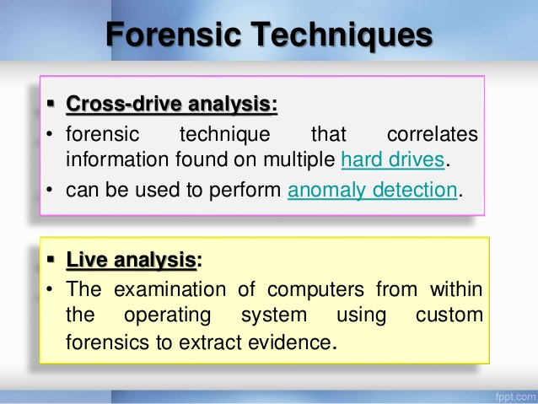

Slide 26
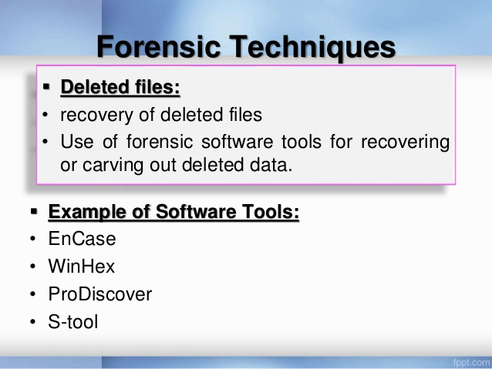

Slide 27
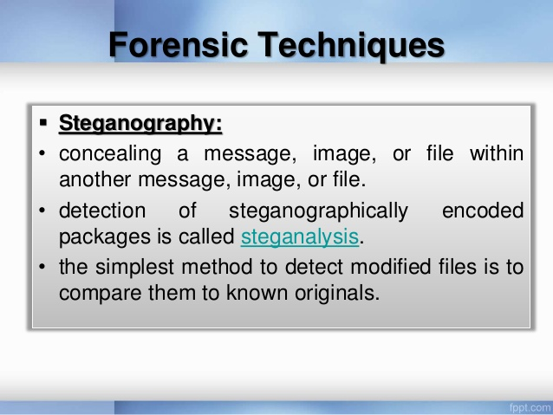

Slide 28
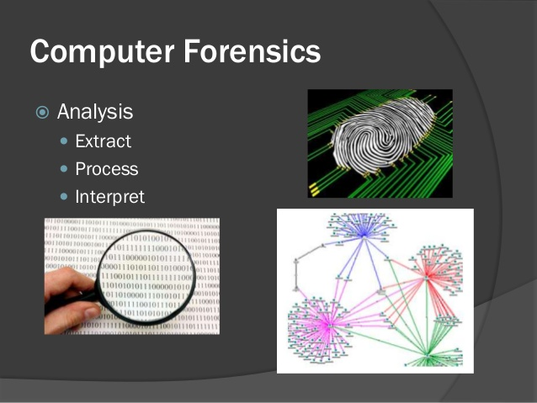
Computer Forensics Process(3)

Slide 29
Computer Forensics Process(3)
The third stage is Analysis.
Analysis is the examination of all digital evidence that has been acquired and authenticated.
The analysis process will be dictated by the examiner and types of digital evidence.
In most situations the analysis will require specialized tools and skills. The tools requires be both software and hardware based.
The goal of the analysis stage is to identify all evidence contained in the digital device and report the results.
Each examiner will have their own approach to analysis.
A collection of tools that you are comfortable with is important.
There are both commercial and open source tools available.

Slide 30
Computer Forensics Process(3)
There are two leading commercial manufacturers of computer forensics software today.
They are AccessData and Guidance Software. In addition to commercial software there are free options such as Linux and other free tools.
Free tools should only be used for examination by someone who has tested and practiced with the tool.
The next logical step refers to when you are done with an investigation.
How do you know that you have found all the evidence related to the case? Do you need to look at every file?
What if you can't find anything?

Slide 31
Computer Forensics Process(3)
It is unreasonable to assume that you can look at every bit of data on the disk.
Depending on your workload and policies, you want to at least look at most of the disk.
The goal is to determine three things.
What is present on the disk?
What is the most likely and supported reason that information is present or absent?
Are there any plausible alternative explanations? Use the data to rule them out.

Slide 32
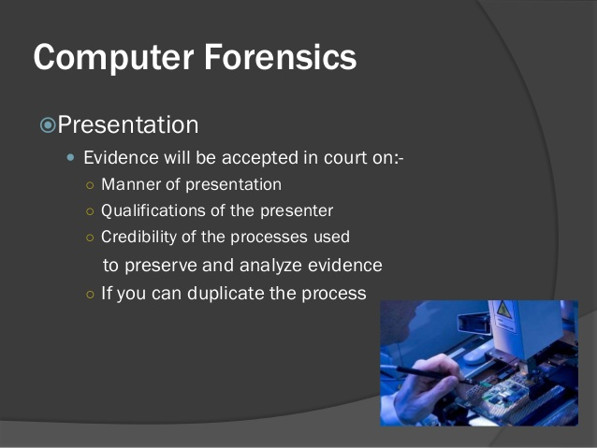
Computer Forensics Process(4)
The final step is to prepare a report that details both your procedure and your findings. Reporting is covered in Advanced Comp Forensic.

Slide 33
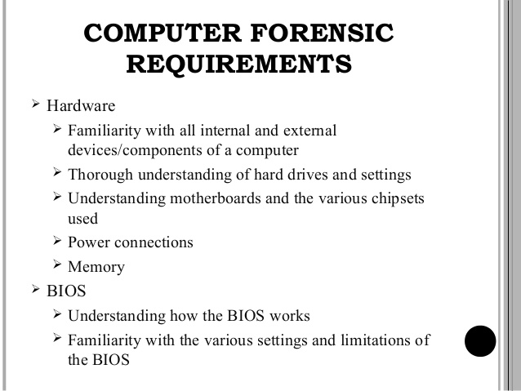

Slide 34
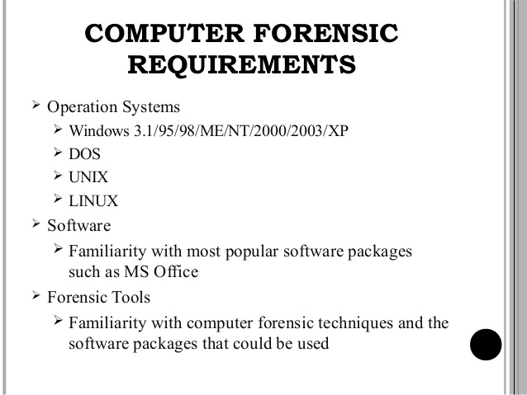

Slide 35
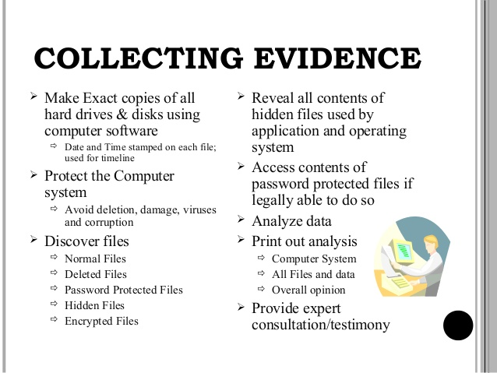

Slide 36
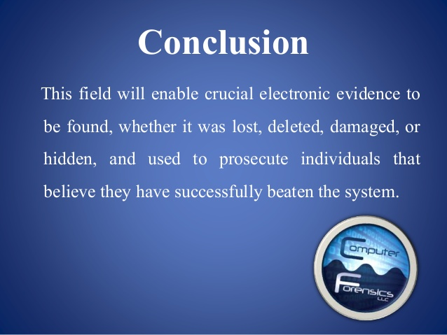

Slide 37


